Slide 1

Flowers
IMAGE EDITING LIBRARY

Slide 2


CONTENTS
Drawing of Line, Rectangle, Circle, Ellipse on a Canvas
Cropping of an Image
Translation of an Image
Rotation of an Image
Flipping of an Image

Slide 3


Drawing a Line
Drawing a Rectangle

Slide 4


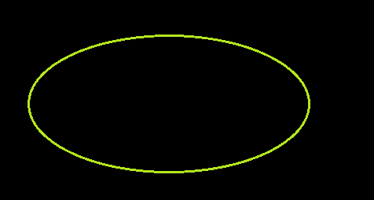

Drawing a Circle
Drawing an Ellipse

Slide 5
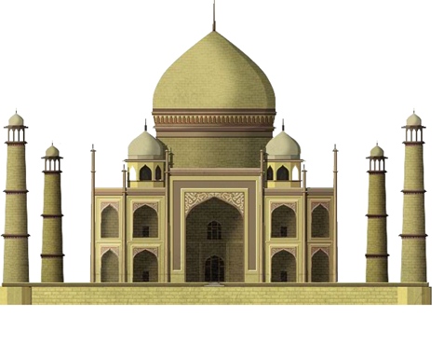
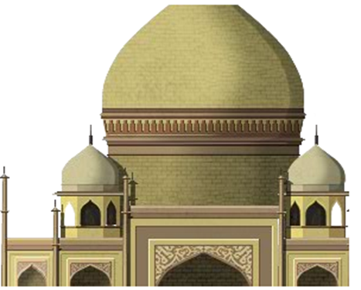
Cropping of an Image
Cropped Image
Original Image

Slide 6


Translation of an Image
Translation in X axis
Original Image

Slide 7



Translation of an Image
Translated Image
Translation in both X axis and Y axis
Translation in y axis

Slide 8
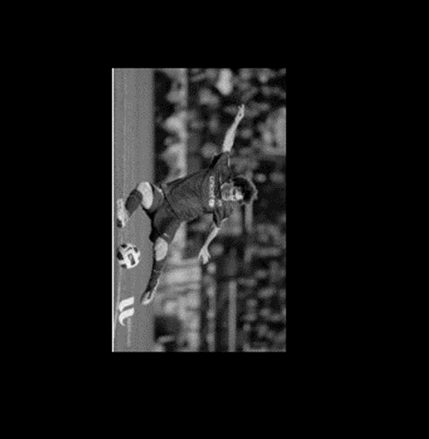
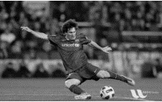
Rotation of an Image
Original Image
Rotated Image

Slide 9


Flipping of an Image
Original Image
Flipped Image

Slide 10
THANK YOU

